Slide 1
Why Python?
Python Course Himastron 2019 | Day 1

Slide 2

What’s Python?
Hello! I’m python :)
Scientific name: Pythonidae
Family: Pythonidae; Fitzinger, 1826
Lifespan: Ball python: 30 years
Mass: Reticulated python: 160 kg
Class: Reptilia

Slide 3
Okay, that’s no funny anymore. Next >

Slide 4

Python is ...
Python is a high level programing language which is easily readable and relatively simple in
comparison to many other high level programming languages such as Java,C, or C++. It has built-in
support for object-oriented programming and functional programming. Python has an incredible
comprehensive documentation which outlines its inherently defined functions and how one can use
them. In addition, Python has many user-created libraries and stacks which one can download and
use in his/her code.

Slide 5
Pros and Cons
PROS
Python is easy to learn for even a novice developer.
Supports multiple systems and platforms.
Object Oriented Programming-driven.
Gives rise to quick development by using less code. Even a small team can handle Python effectively.
Allows to scale even the most complex applications with ease.
A large number of resources are available for Python.
CONS
Python is slow, but …
Python is not a very good language for mobile dev.
Python is not a good choice for memory intensive tasks.
It's near impossible to build a high-graphic 3D game using Python.
Has limitations with database access.
Python is not good for multi-processor/multi-core work.

Slide 6
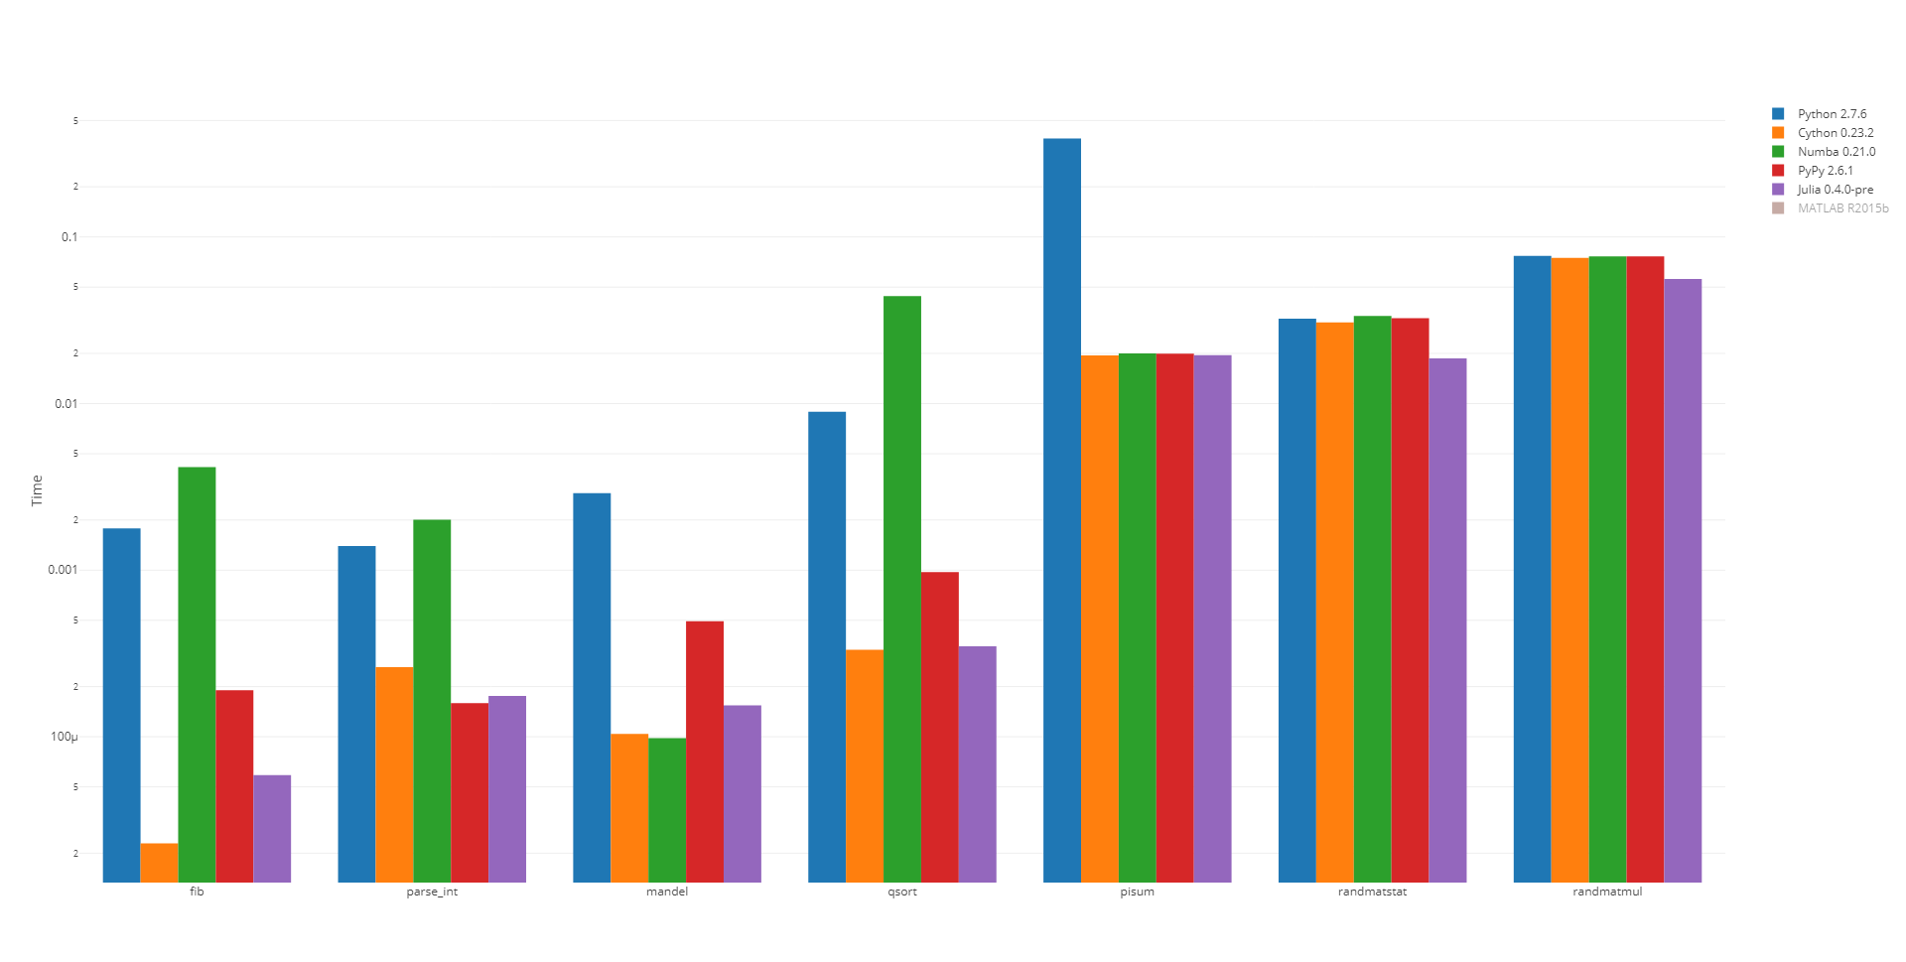
Python ♥ JIT

Slide 7
Enjoy the next training :)

